Slide 1

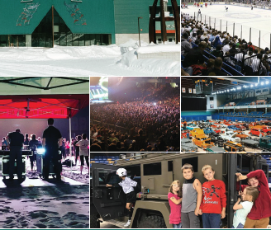
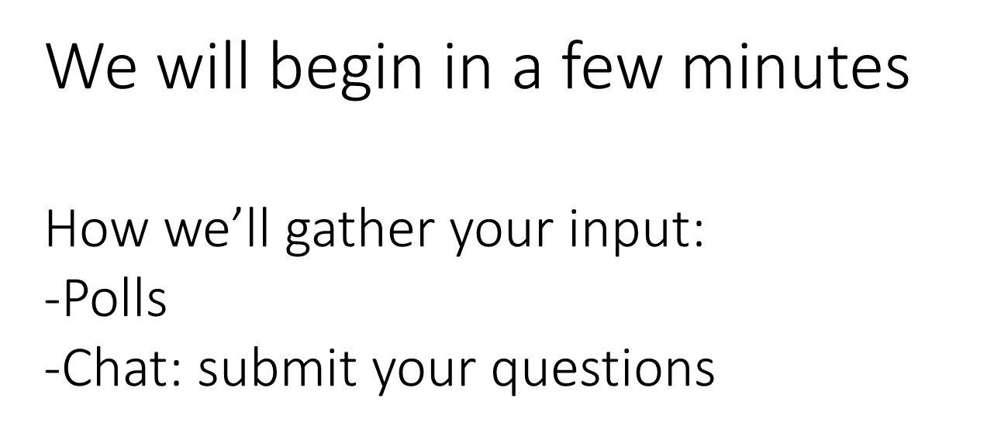
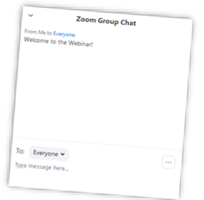

Fairbanks North Star Borough
Parks & Recreation
Carlson Center Feasibility Study
Findings Presentation October 29, 2020

Slide 2
FBNS Voices
November 17, 2020 Final Report Webinar Presentation
October 29, 2020 Findings Webinar Presentation
July 27, 2020 - 2 Focus Groups - 16 participants
July 29, 2020 - 4 Stakeholder Interviews -14 participants
July 30, 2020 Public Zoom Webinar – 118 participants
August/September 2020 - 1,845 Completed Surveys
Notes:
What we know:
The venue is the largest of its kind in the area, and serves Fairbanks and surrounding communities in the Interior of Alaska
Hosts a variety of events, including the University of Alaska Fairbanks hockey games, other hockey teams, graduations, conferences, festivals, Alaska Federation of Native concerts, and much more.
Surrounding the Carlson Center are Pioneer Park and the Alaska Centennial Center for the Arts, offering smaller event spaces at more reasonable prices.
The Centennial Center is an older building that is undergoing structural renovations. The FNSB does not expect the Centennial Center to remain open in perpetuity, it is likely that the needs currently served by this building may need to be accommodated elsewhere.

Slide 3
Carlson Center SMG of Alaska management agreement expires on June 30,
Engagement of community, staff, and stakeholders
Identification of community needs
Evaluation of current facility operations & maintenance
Assessment of FNSB Parks and Recreation
Assessment of partnerships,
Development of recommendations for the best method to manage the Carlson Center.
Objectives for this plan include:
Notes:
What we know:
The venue is the largest of its kind in the area, and serves Fairbanks and surrounding communities in the Interior of Alaska
Hosts a variety of events, including the University of Alaska Fairbanks hockey games, other hockey teams, graduations, conferences, festivals, Alaska Federation of Native concerts, and much more.
Surrounding the Carlson Center are Pioneer Park and the Alaska Centennial Center for the Arts, offering smaller event spaces at more reasonable prices.
The Centennial Center is an older building that is undergoing structural renovations. The FNSB does not expect the Centennial Center to remain open in perpetuity, it is likely that the needs currently served by this building may need to be accommodated elsewhere.

Slide 4


No Decisions have been made.
We want your input!

Slide 5


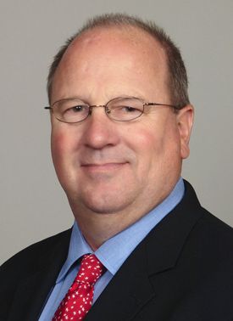
Your Team
Pat O’Toole, Principal
Principal in Charge GreenPlay, LLC
Tom Diehl, Principal
Project Manager, GreenPlay, LLC

Slide 6
FNSB Demographics
104,081
2020 Population
Source: Esri Business Analyst, 2020
103,867
2025 Population Projection
Source: Esri Business Analyst, 2020
103,659
2030 Population Projection
Source: Esri Business Analyst, 2020
Fairbanks North Star Borough ranked 6 out of 25 Alaska Counties for Health Outcomes
33.3%
2020 Median Age
Source: 2020 Esri Business Analyst
27%
population ages 20 to 34 years old.
Source: 2020 Esri Business Analyst
34.4%
2025 Projected Median Age
Source: 2020 Esri Business Analyst
In 2020, approximately 73 percent of residents identified as White and eight percent identified as American Indian/Alaska Native in Fairbanks North Star Borough.
$75,334
Median Household Income
Source: 2020 Esri Business Analyst
$249,314Median Home Value
Source: 2020 Esri Business Analyst
2.55 people
Average size of Household 2020
Source: 2020 Esri Business Analyst
Source: 2020 Esri Business Analyst;

Slide 7
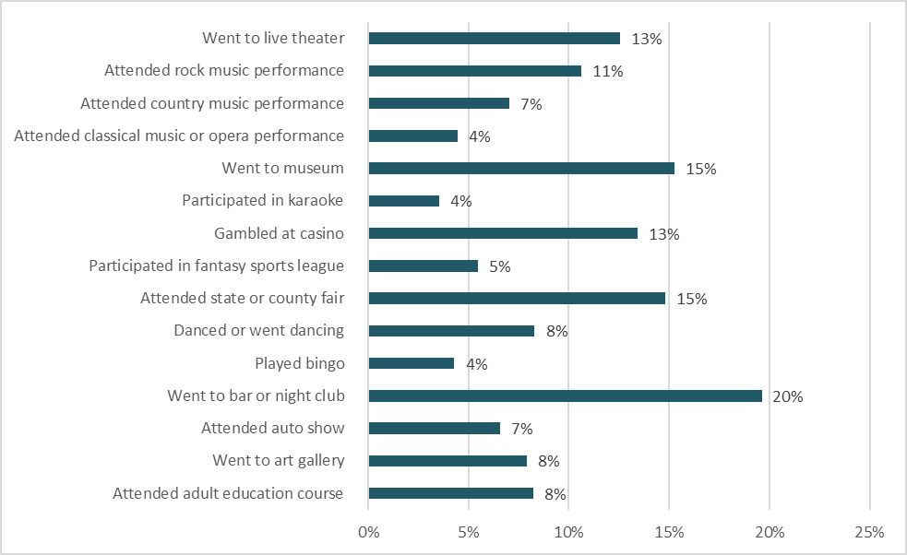
Trends Relevant to FNSB
Leisure Activity Participation in the Fairbanks North Star Borough
Source: 2020 Esri Business Analyst

Slide 8
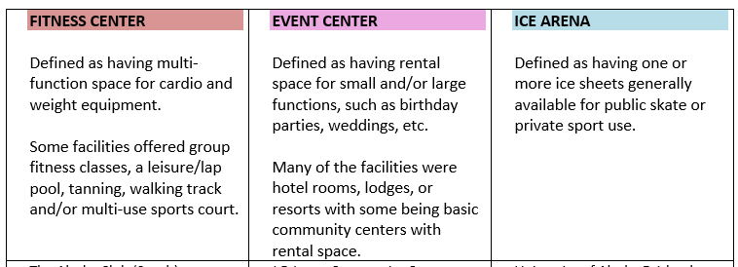
FNSB Carlson Center Market Analysis
A key component of determining the feasibility of the Carlson Center is to look at alternative providers who offer similar services through a market analysis. This inventory of like-service providers can assist with understanding the area’s current facilities and how they may overlap with the potential services of the Carlson Center.

Slide 9
FNSB Carlson Center Alternative Providers

Slide 10
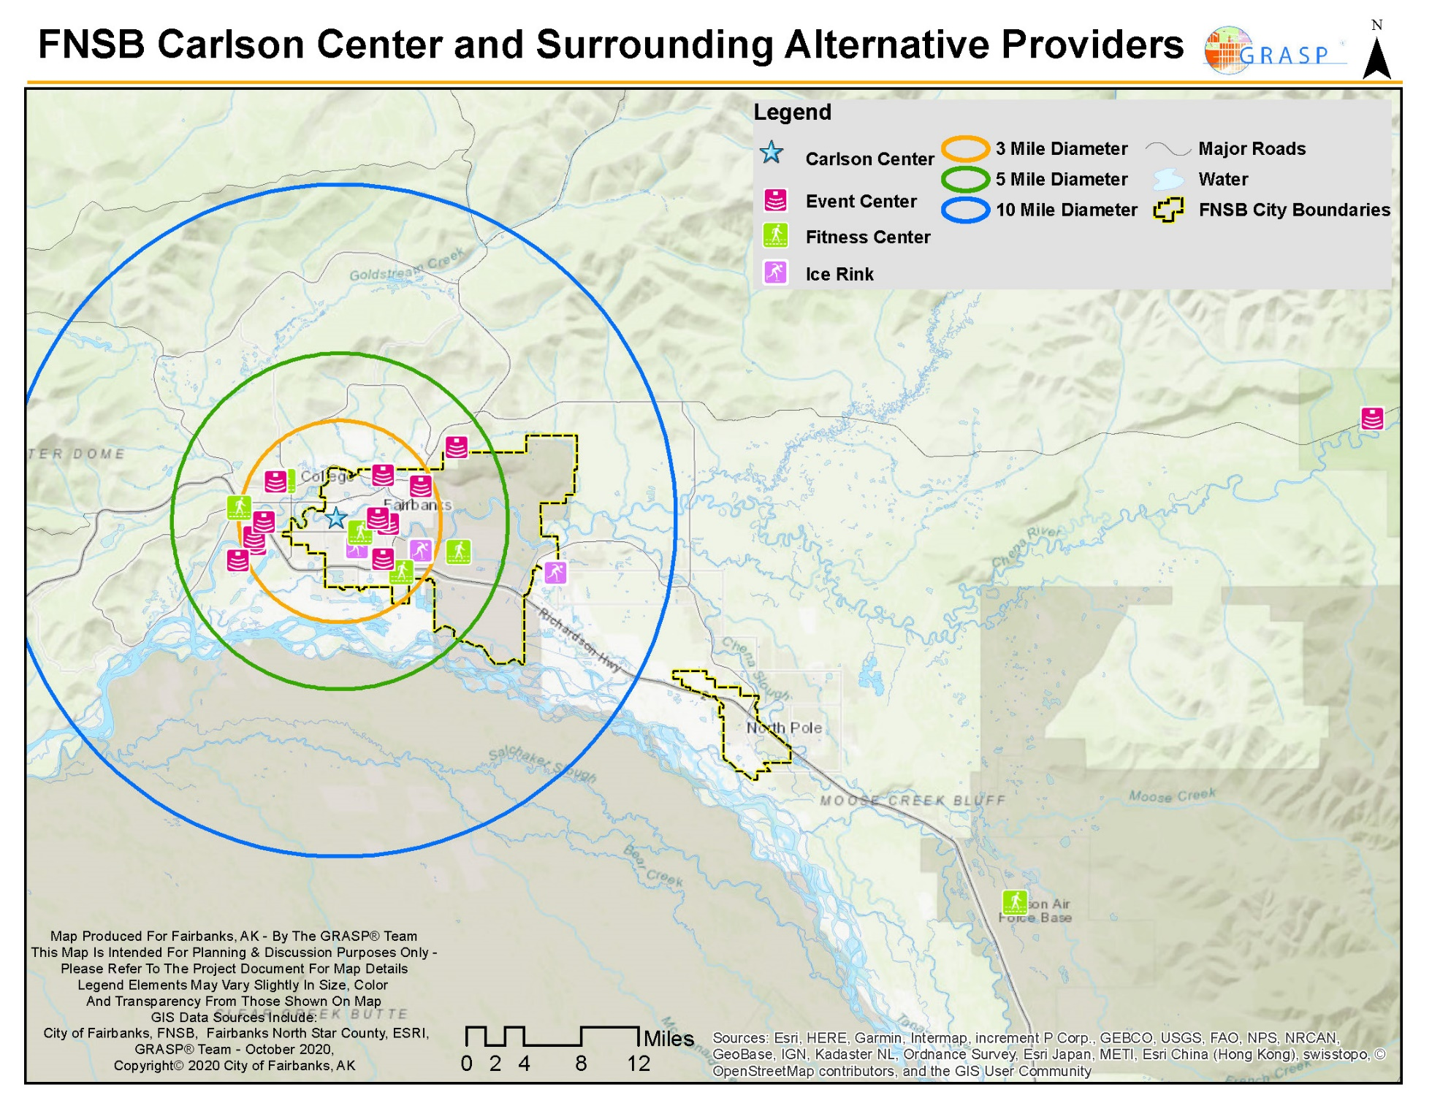
FNSB Carlson Center Alternative Providers Map

Slide 11
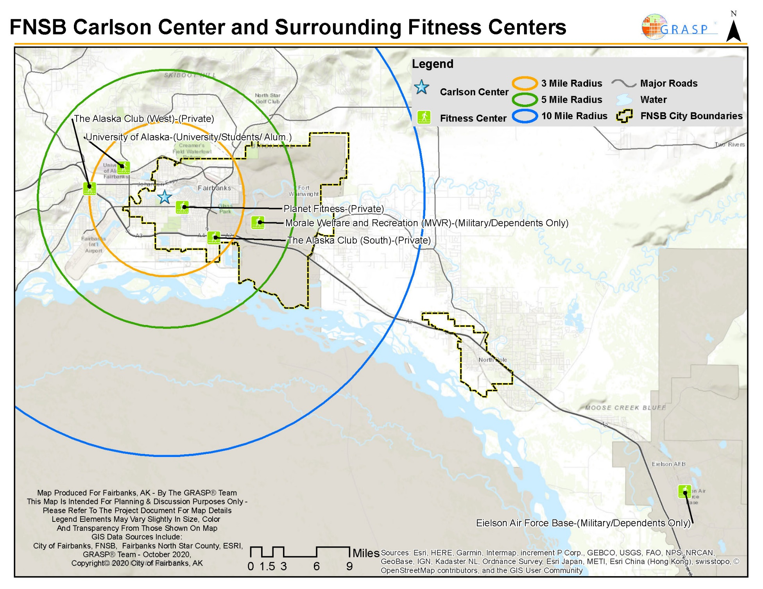
FNSB Carlson Center Surrounding Fitness Centers Map

Slide 12
FNSB Carlson Center Alternative Fitness Centers Key Takeaways
Fitness Centers: Analysis of the fitness centers identified in the study indicate that there may be opportunity for a community-wide recreation center to service the Borough. Within five miles of the Carlson Center, there are five fitness facilities, two of which are restricted in access – one is owned by the University of Alaska, and the other is owned by Morale Welfare Recreation (WFR). There are no "true" multipurpose community centers with recreational activities for all ages/interests in the service area - only fitness centers with the exception of the private Alaska Club (South).

Slide 13
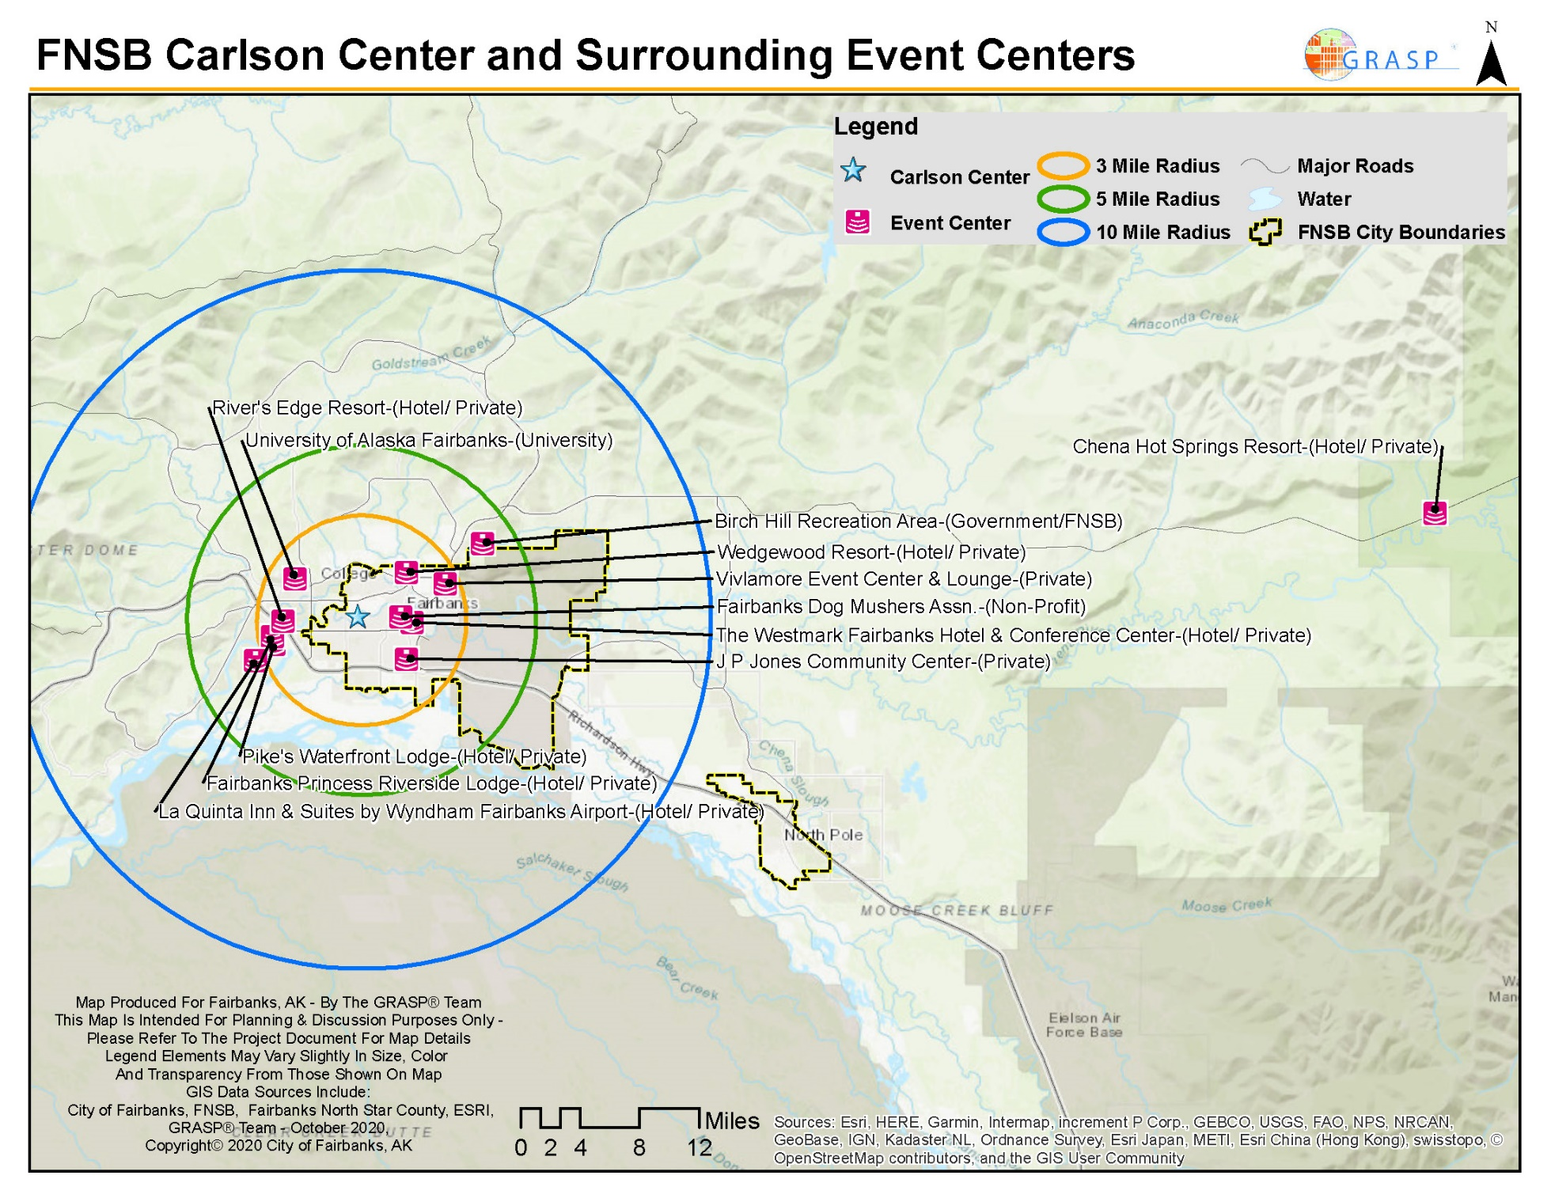
FNSB Carlson Center Surrounding Event Centers Map

Slide 14
FNSB Carlson Center Alternative Event Center Key Takeaways
Event Centers: Event centers are facilities that offer rental of facilities to patrons for special events. The majority of these facilities were hotels, resorts, or community centers with meeting rooms for rent. Within five miles of the Carlson Center ten alternative providers were identified as event centers.
Many of the identified alternative providers within five miles of the Carlson Center are event facilities. These facilities primarily focus on providing rental space for special events, weddings, and other gatherings that require lodging and/or room rentals. Yet, in the immediate area, there is a lack of convention centers that could offer space for larger events such as trade shows and concerts. The data suggests that the market is saturated with facilities offering specialized room space for smaller or personal gatherings.

Slide 15
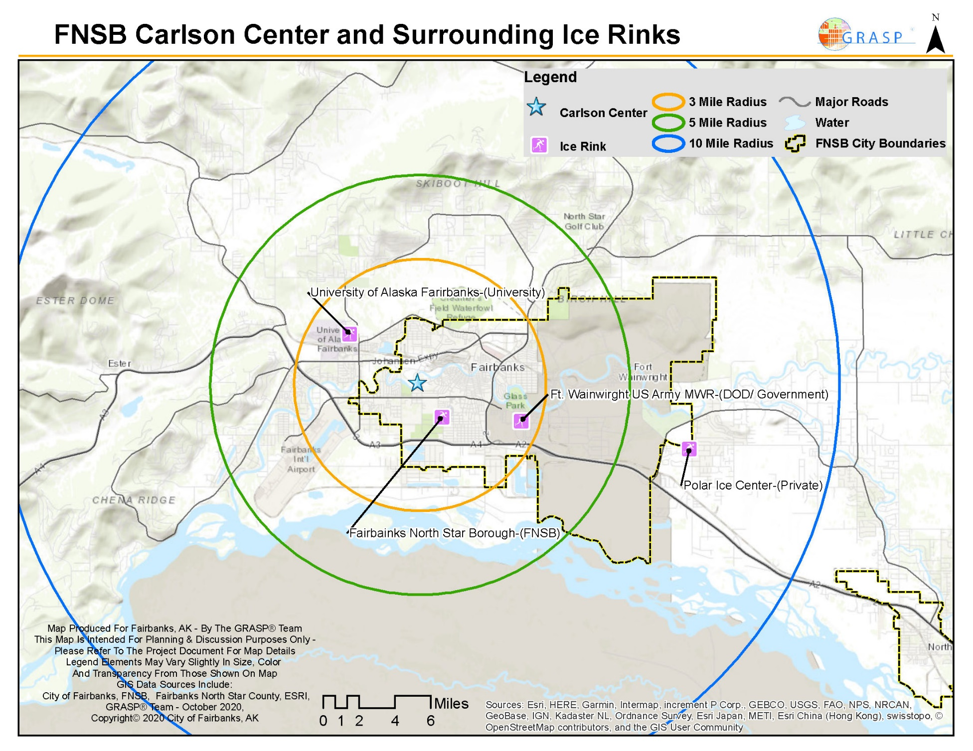
FNSB Carlson Center Surrounding Ice Rinks Providers Map

Slide 16
FNSB Carlson Center Alternative Ice Rinks Key Takeaways
Ice Arenas: There are four ice arenas within ten miles of the Carlson Center, which offer opportunities for public skate and ice rentals for team sports. This data suggests that the market is saturated with ice arenas, and the addition of that amenity in the Carlson Center may be considered a duplication of these services.
In the surrounding region there are also ice arenas present in Delta Junction (95 miles) and Anchorage (360 miles), each at considerable distance from Fairbanks.

Slide 17
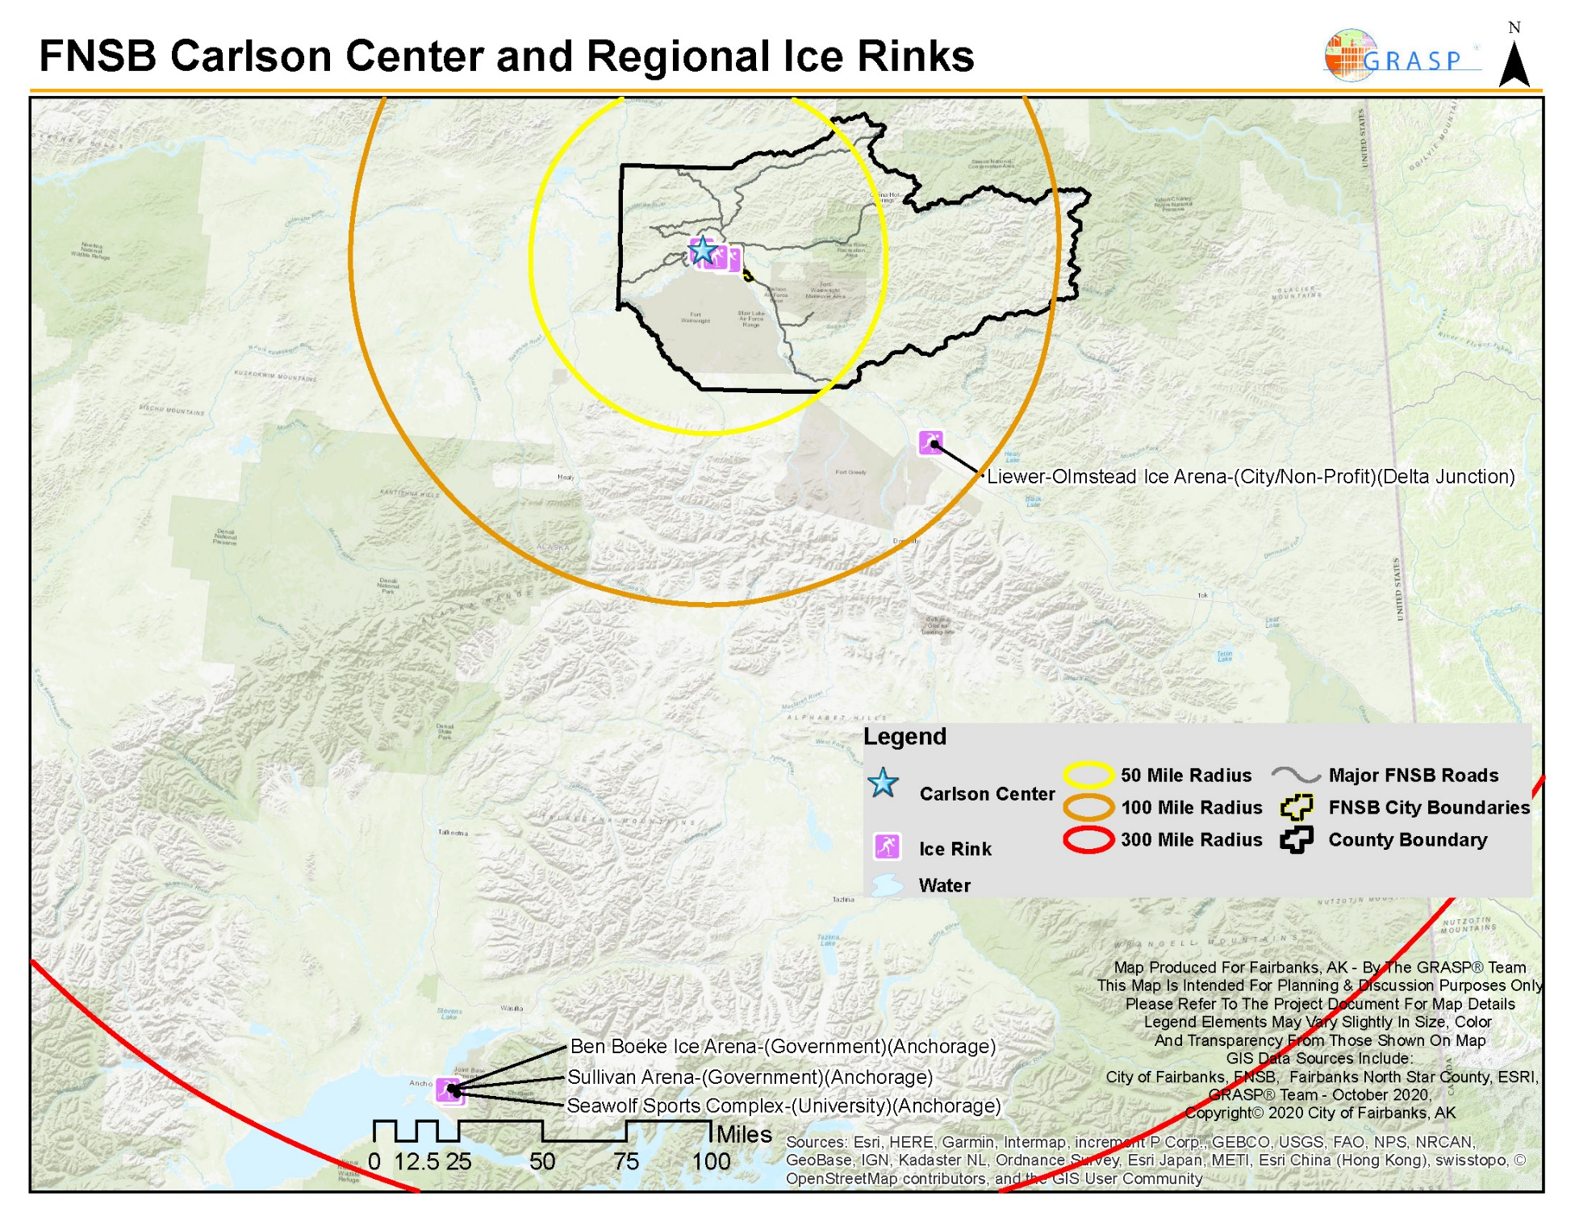
FNSB Carlson Center Regional Ice Rinks Map

Slide 18
  Convention/Event users
  Key Stakeholders
  Hockey, Soccer, Basketball
  Military
  University
  Rotary Club
  Veterans
  Business Owners
  Parks & Recreation staff
  Borough Leadership
  University Athletics
  ASM Global
Public Engagement
1,993+
2 Focus Groups - 16 participants
4 Stakeholder Interviews -14 participants
1 Public Zoom Webinar – 118 participants
1,845 Completed Surveys
Participants

Slide 19
Desired Additional Activities for the Carlson Center – Focus Groups
Indoor soccer
Fitness classes
Daytime PE activities for homeschoolers (FYSA sublease of facility, fund arena turf surface) – clinics, classes, programs, etc.
Physical activities for multiple groups during winter (like Big Dipper walking groups)
Birthday parties
Flag football
Lacrosse
Kickball

Slide 20
Desired Additional Events for the Carlson Center – Focus Groups
Indoor soccer, baseball, softball, lacrosse, flag football, indoor football, basketball, volleyball
Youth hockey games/practices
Large events – only facility in area that can host large events
Smaller trade shows/Conventions
Community-wide festivals - “A day in the life of Fairbanks”
Art shows/Artisan gatherings
Wedding receptions
Weekday activities
Turf time for tots
Food trucks
Track meets

Slide 21
Opportunities for the Carlson Center – Focus Groups
Youth, Preschool, Teen, community programs/activities
Partner with Pioneer Park – Program/Combined use
Indoor Turf – Soccer, Baseball, Softball, Indoor Playground, etc.
Gymnasiums – Basketball
Promote year-round activities
Consolidating Parks & Recreation functions into Carlson Center
Fort Wainwright/MWR Partnership for events/activities
Fitness/Cardio/Weights, Walking Track, Fitness classes/programs
Outdoor events with indoor amenities such as catering kitchenr
Open skate times
Meetings/Conventions, concerts
Guest Services Kiosk

Slide 22
Carlson Center Primary Function – Focus Groups
Maximize community access and participation
Indoor turf space during non-hockey times – system for inside the dasher boards as well as the entire space without the dasher boards
Indoor community gathering
Physical recreation/fitness space
Reduced pricing for community groups
Venue for large events (economic impact to community)
Multipurpose uses/activities
Be able to transition spaces for different activities
Keep the Division I hockey program as a priority

Slide 23
Additional Amenities for the Carlson Center – Focus Groups
Indoor turf, flexible netting between turf fields, spectator seating
Indoor ropes course/obstacle course/adventure course/indoor playground (can drop down from ceiling)
Covered outdoor event space, large event space/venue
Walking track, adventure track, competitive track
Traffic controls (traffic lights, stop signs, roundabout, etc.)
Multipurpose space
Storage, Locker Rooms
Fitness/weights/cardio space, Cross Training / fitness amenities
Gymnasium space
Food options, Kitchen expanded/ Teaching kitchen, Food truck space

Slide 24
Top Priorities – Focus Groups
Serving community, increased usage-daily, offer recreational programs to community
Sports, athletic and fitness needs for all ages
Develop community supported mission/vision for the Carlson Center
Indoor turf, hockey, soccer
Trade shows/events
Lower fees and increase value to community
Fiscal / Cost Recovery
Decisions made by end of 2020
Energy upgrades
Improved ice arena
Operated by FNSB versus private management company
Large event space – trade shows, conferences, events, concerts, etc.

Slide 25
Vison for the Carlson Center – Focus Groups
Carlson Center should function as a Community/Visitor Center – more diverse than hockey
Expand community use/community friendly – activities
Needs to be community based for year-round activities for local participation
Based on what the Borough/community wants it to be
“Community Center”
Ice less of a focus moving forward
Concerts, events, etc. as a focus
Balance what the community wants with a good business model of cost recovery
Hockey venue for University and community

Slide 26
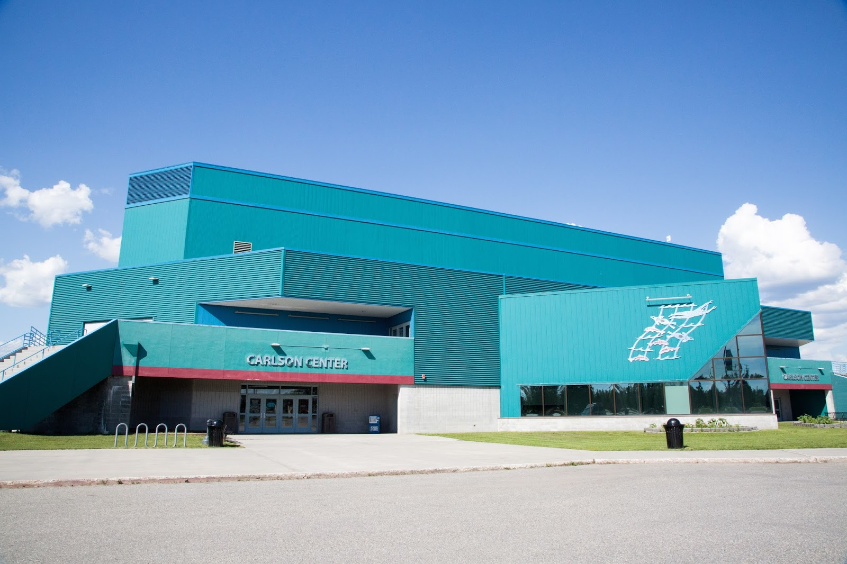



Fairbanks North Star Borough
Carlson Center Management Feasibility Study & Community Survey

Slide 27

Introduction
The purpose of this study was to assess community needs and desires with focus on both management aspects and possible renovation of the Carlson Center.
This survey research effort and subsequent analysis were designed to assist Fairbanks North Star Borough Parks and Recreation Department in developing a long-term plan to reflect the community’s needs and desires.

Slide 28


Methodology
Primary methods:
1 = Statistically Valid (Invitation Survey)
Mailed survey with an option to complete online through password protected website
2 = Open Link Survey—online survey made available to all residents in the Fairbanks North Star Borough area
1,845
4,500 Surveys Mailed
Total
Completed
Surveys
452 -
Invitation Surveys Completed
+/- 4.6
Margin of Error
1,393 -
Open Link Surveys Completed

Slide 29




Demographic
Profile
(Invitation Sample)
Which area of Fairbanks North Star Borough do you live:
  22% - City of Fairbanks
  21% - West Fairbanks, University, Ester
  14% - East Fairbanks, Gilmore, Chena Hot Springs
  13% - City of North Pole
  11% - North Fairbanks, Fox, Gold Stream
  11% - Outlying North Pole area, Salcha, Badger
  5% - Fort Wainwright
  3% - Other
23.7
Average number of years
living in Fairbanks North Star Borough
57% Female
33% Male
79% of respondents own their residence / 16% rent
11% Active Duty Military
8% of respondents have a need for ADA accessible facilities and amenities

Slide 30
Participation
Familiarity
69% of respondents are current users of Alaska Centennial Center for the Arts programs and facilities
87% of respondents use programs or facilities at the Carlson Center.
36% of respondents are very familiar with the Alaska Centennial Center for the Arts, 27% are moderately familiar, 36% are not familiar
56% of respondents are very familiar with the Carlson Center, 29% are moderately familiar, 15% are not familiar
30

Slide 31
Carlson Center
Increasing use
Renovation
Combining Centennial Center/ Carlson Center
73% more programs/community events, 48% improved communication about offerings,
45% more facilities and amenities, 43% lower pricing/user fees for rentals
41% renovation very important, 28% somewhat important
56% of respondents are very familiar with the Carlson Center, 29% are moderately familiar, 15% are not familiar
31

Slide 32
Importance
Needs Met
Special events/festivals (4.1/4.2), concerts (3.9/3.8), trade shows (3.9/3.7), overall Carlson Center facility (3.7/3.9) as most important to their household
Support of UAF Hockey( 3.2/3.3) and quality of rink and ice surfacing (3.1/3.3)
Trade shows (4.0/3.5), support of UAF Hockey program (3.5/3.9), and special events/festivals (3.9/3.4) were the top three meeting the community needs the best
Current Facilities and Programs
32

Slide 33
Importance- Performance Matrix
High importance/ Low needs met
High importance/ High needs met
These are key areas for potential improvements. Improving these facilities/programs would likely positively affect the degree to which community needs are met overall.
These amenities are important to most respondents and should be maintained in the future but are less of a priority for improvements as needs are currently being adequately met.
These “niche” facilities/programs have a small but passionate following, so measuring participation when planning for future improvements may prove to be valuable.
Current levels of support appear to be adequate. Future discussions evaluating whether the resources supporting these facilities/programs outweigh the benefits may be constructive.
Low importance/ Low needs met
Low importance/ High needs met
33

Slide 34
Importance- Performance Matrix
(Invitation Sample)
34

Slide 35
Importance- Performance Matrix
(Open Link)
35

Slide 36
Future Needs for the Carlson Center
Top 3 Future Needs for the Carlson Center
More special events (4.2/4.0)
Increase utilization/more inclusive (3.8/4.1)
Support for University of Alaska Fairbanks Hockey (30%)
Increase utilization/more inclusive (53%)
More special events (60%)
36

Slide 37
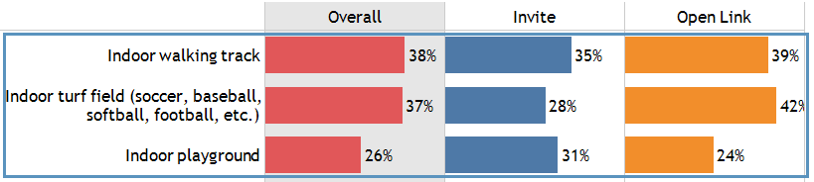
Top Carlson Center Renovations
Top 3
Fitness - indoor walking track, an indoor turf field, locker rooms/restrooms, and a multi-activity gym.
Youth - indoor playground and youth after-school activities/classroom areas.
Other - space for arts and culture, community meeting rooms/event spaces, small-separate auditorium and theater, and a multi-purpose classroom.
37

Slide 38
Values & Vision
Providing affordable activities and facilities to all (4.2), continuing to focus on providing family-oriented activities (4.1), and ensuring parks and recreation opportunities are accessible to all residents (3.9) are the top three most important values for Fairbanks North Star Borough to focus on in its mission for the future. Also important is increasing community usage capacity at the Carlson Center (3.8), keeping up with growth (3.7), and enhancements to existing facilities (3.6).
38

Slide 39
Values & Vision
(List continued)
Continuing, offering cultural events, festivals, and activities to reflect diversity and inclusivity also rates high (3.7), as does safety and security (3.6), strengthening community image and sense of place (3.6), and maintaining what is currently available (3.5). Conversely, more than half of invite and open link respondents do not feel it is important to focus on providing exclusive use of the ice arena to the University of Alaska Fairbanks.
39

Slide 40
Funding Sources
Approximately 72% of invite respondents would definitely or probably support more private/public partnerships and 67% would support sponsorship/naming rights as potential sources for funding recommendations from this survey. Over half (56%) show moderate support for a bond referendum for specific projects. Conversely, 60% would not support increased property taxes, and 51% would not support a new dedicated sales tax. Support for a new hospitality tax is more mixed.
40

Slide 41
CARLSON CENTER MANAGEMENT SCENARIOS
In terms of management of the Carlson Center (respondents were first explained the current situation—see survey for specific language), respondents indicate that they would like a hybrid scenario, where the Borough manages the facilities and hires contractors as needed (40%). Another 29% of the respondents do not know or are uncertain of which management option is best. Only 10% prefer the current scenario (contractor managed), while 16% prefer the Borough manages all operations. Both invite and open link samples were similar in responses.
41

Slide 42
Community Comments
At the conclusion of the survey, respondents were given the opportunity to provide any further comments regarding facilities and programs at the Carlson Center (see full list in the Appendix). A random selection of verbatim responses is shown below.
You have an opportunity to increase the health of the community through indoor walking and
playground, help youth through after-school programs, help mental health through brightly-lit
activity spaces and short-term classes. This could truly be a community center if use is
broadened to include the entire community—through better transportation and a variety of
free or low-cost drop-in activities. Book it solid with sports or cultural events and you exclude
people who can't pay the ticket prices.
Need mid-size facility like Centennial Center. Carlson Center too big for many events. Rebuild Centennial Center. DO NOT eliminate Centennial Center.
I don't know if whoever is reading this remembers The Center where the old Sears was but
that place was AWESOME. Movie theater, bowling alley, arcade, skating rink, candy store--a
place for kids to hang out and stay away from trouble. Kids don't have anything like that here. No arcade. Not even a skating rink. We need more things for young people to do.
Less industrial vibe. Aesthetics and sound. Mishmash design that barely adequately suits a mishmash of activities. Complete overhaul and rebuild to serve small and large functions.
Need more than just hockey. Fairbanks is a melting pot of people from all over the world.
42

Slide 43
Community Comments
Please just continue what currently occurs at CC, just better (i.e. fix the ice, maintain the bldg.). No need for expanded services, just improved services.
More publicity before events is badly needed. Too often don't read about something till it's happening. Should be in News Miner.
Ability to have indoor soccer and basketball at the Carlson Center would be awesome! I believe keeping Carlson Center sport and event-focused and providing a separate facility for the arts will serve the two very different program needs much better than trying to fit it all into the Carlson Center.
UAF Hockey should be played on University's buck. Run Alaska land for tourists, with private contractors. Borough should stay out of entertaining the public.
Open a turf field in building
River access at Carlson Center upstream at Pioneer Park to relive congestion at Paddlers Cove.
I suggest that the hockey game tickets be lowered. A family of four cannot afford to attend a game, fill the stands!!
Indoor fitness facility for Fairbanks is NEEDED. I'm shocked we don't have such a thing here.
I like the idea of the facility being a destination any day of the week for a variety of activities and not just big events once a month and sitting vacant the rest of the time.
43

Slide 44





Key Survey Findings
IMPORTANCE OF RENOVATING THE CARLSON CENTER
PARTICIPATION
Renovating the Carlson Center is somewhat or very important to about two-thirds of invite respondents (64%). Open link respondents exhibit slightly stronger opinions on the importance of renovating the Carlson Center (71% somewhat or very important).
83% of invite respondents are current users of activities/programs/facilities at the Carlson
Center. Open link respondents are more likely to be participants, with 88% being current users. Use of the Alaska Centennial Center for the Arts is somewhat less although still substantial at 68-69% for both samples.
COMBINING OPERATIONS OF THE CENTENNIAL CENTER
INCREASE USE
Fewer although a slight majority support moving or combining operations of the Centennial Center with the Carlson Center (56%). Comments note the need for a “mid-size” facility like the Centennial Center and that it should be rebuilt and not eliminated (financial support for this effort is also suggested). Carlson Center does not have the variety/capacity to accommodate everything.
More programs/community events (73%), improved communication about offerings (51%), more facilities/amenities (41%), and lower pricing/user fees for rentals (41%) were among the top items that would increase use of the Carlson Center.

Slide 45




Key Survey Findings
FUTURE NEEDS
NEW SPACES/AMENITIES
By far, more special events—including concerts, expos, festivals, non-profit events, educational seminars, parties, and wedding receptions—is the most important need for the future at the Carlson Center (70%), followed by utilizing the Carlson Center as more of an inclusive community center for all members of the public (47%). Support for UAF hockey along with new ice is more of a secondary consideration.
An indoor walking track is the most important amenity that residents would like to see included in the renovation of the Carlson Center (35%). Indoor playground (31%) and indoor turf field (28%) are important as well. The open link sample is especially enthusiastic about the indoor turf field (41%). The need for more opportunities for entertainment, activity, and to interact with others (given Fairbanks’ isolated location and long, dark winters) is expressed throughout the comments.
INCLUSIVE COMMUNITY CENTER
Many comments also call for and support the Carlson Center becoming more community oriented and focused towards a variety of sports/activities (in addition to hockey), large events, and education, while developing and maintaining the Centennial Center for arts, community, and smaller group events.
INDOOR TURF FIELD
Many of the comments specifically focus on the need for an indoor turf field or field house, particularly for soccer and tennis, and that the focus should not be solely on hockey. Fairbanks’ competitive disadvantage (compared to other communities) is also noted.

Slide 46




Key Survey Findings
VALUES & VISION
FUNDING SOURCES
Providing affordable activities and facilities to all, continuing to focus on providing family-oriented activities, and ensuring parks and recreation opportunities are accessible to all residents are the top three most important values for Fairbanks North Star Borough to focus on in its mission for the future.
More private/public partnerships and sponsorships/naming rights have strong support as potential funding sources. There is also relatively strong support for a bond referendum for specific projects, but not for new property or sales taxes. Support for a hospitality tax is more mixed.
MANAGEMENT SCENARIOS
COMMUNICATION
The hybrid management scenario (Borough manages facilities and hires contractors as needed) is the most preferred by 40%, although a large number, 29%, don’t know or are uninformed on the issue.
The most preferred methods to receive information on facilities, services, and programs provided at the Carlson Center is through local media (63%), followed by social media (56%), and email (32%). Results demonstrate a need to maintain diversify in communication methods.

Slide 47
Findings Recurring Themes
Maximize usage of Carlson Center
Serve entire community, increased usage-daily
Provide an indoor recreation space during the long cold winter
Recreation, sports, athletic & fitness programs for entire community
Develop community supported Carlson Center mission/vision
Indoor turf, playground, hockey, soccer, walking track/adventure course
Large multi-purpose space - for recreation, trade shows, conferences, events, concerts, etc.
Lower fees and increase value to community
Fiscal/Cost Recovery
Operated by FNSB versus private management company

Slide 48
Other comments, suggestions, feedback?

Slide 49
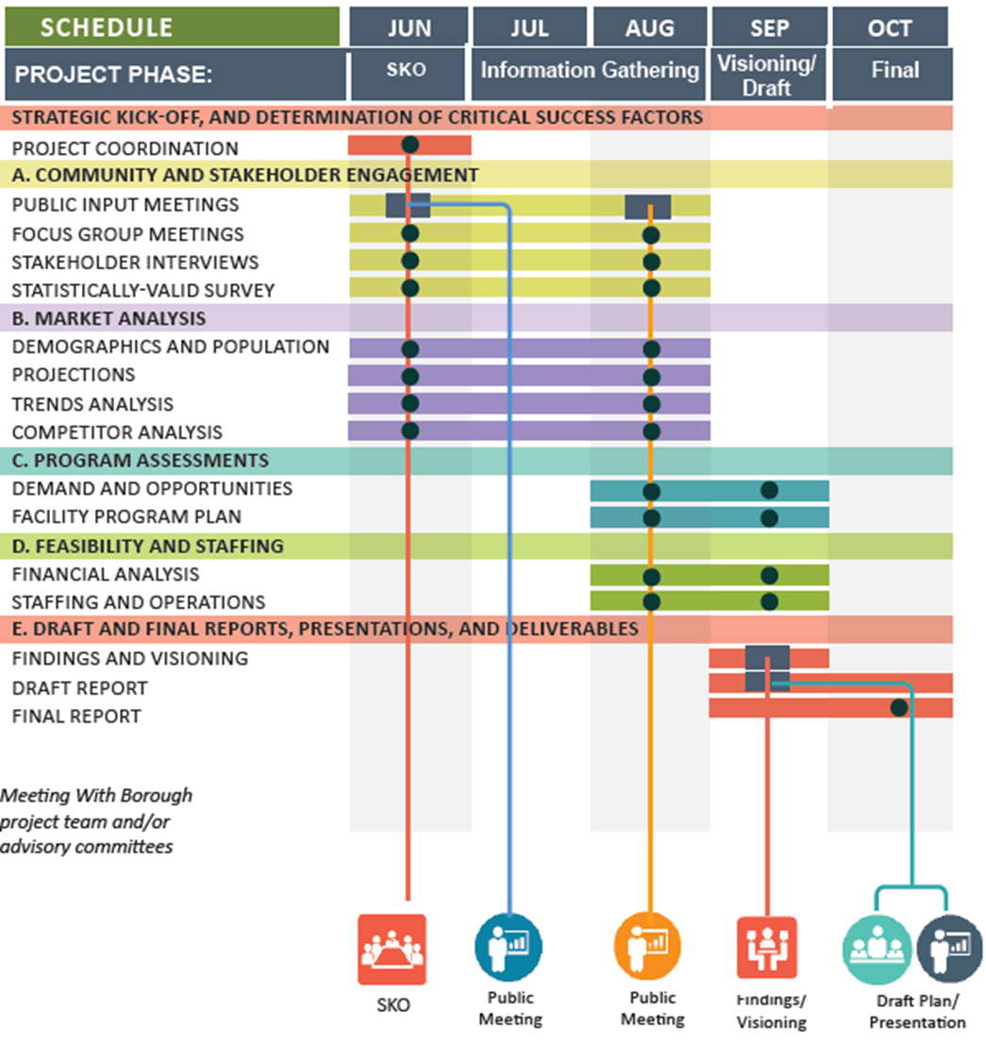
Next Steps
November 17, 2020 Final Report Webinar Presentation

Slide 50

Thank You For Your Time & Consideration!
Pat O’Toole , Principal
Principal in Charge
Direct: 303-345-1804
Pato@greenplayllc.com
Tom Diehl, CPRP, Principal
Project Manager
Direct: 804.833.6994
Tdiehl@greenplayllc.com

