Slide 1

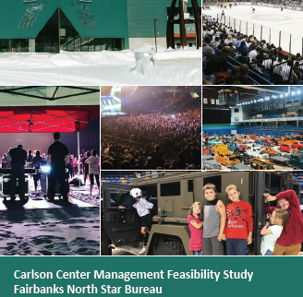
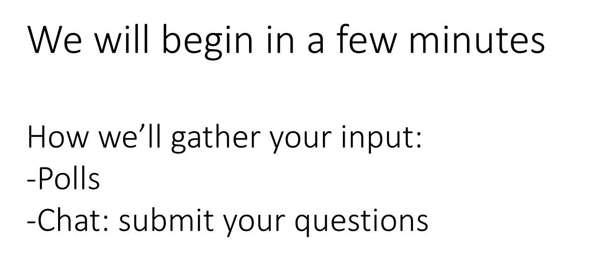
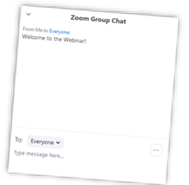

Initial Public Forum July 30, 2020

Slide 2
The Fairbanks North Star Borough Parks & Recreation is conducting a Feasibility Study for the management of the Carlson Center. The objectives for this plan include identification of community needs; evaluation of current facility operations and maintenance; assessment of FNSB Parks and Recreation; assessment of partnerships, engagement of community, staff, and stakeholders; and development of recommendations for the best method to manage the Carlson Center.

Slide 3
What we know:
Carlson Center SMG of Alaska management agreement expires on June 30, 2021.
The venue is the largest of its kind in the area, and serves Fairbanks and surrounding communities in the Interior of Alaska
Hosts a variety of events, including the University of Alaska Fairbanks hockey games, other hockey teams, graduations, conferences, festivals, Alaska Federation of Native concerts, and much more.
Surrounding the Carlson Center are Pioneer Park and the Alaska Centennial Center for the Arts, offering smaller event spaces at more reasonable prices.
The Centennial Center is an older building that is undergoing structural renovations. The FNSB does not expect the Centennial Center to remain open in perpetuity, it is likely that the needs currently served by this building may need to be accommodated elsewhere.

Slide 4

No Decisions have been made.
We want your input!

Slide 5


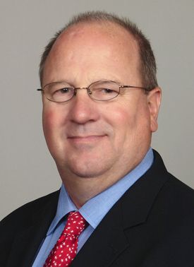
Your Team
Pat O’Toole, Principal
Principal in Charge GreenPlay, LLC
Tom Diehl, Principal
Project Manager, GreenPlay, LLC

Slide 6
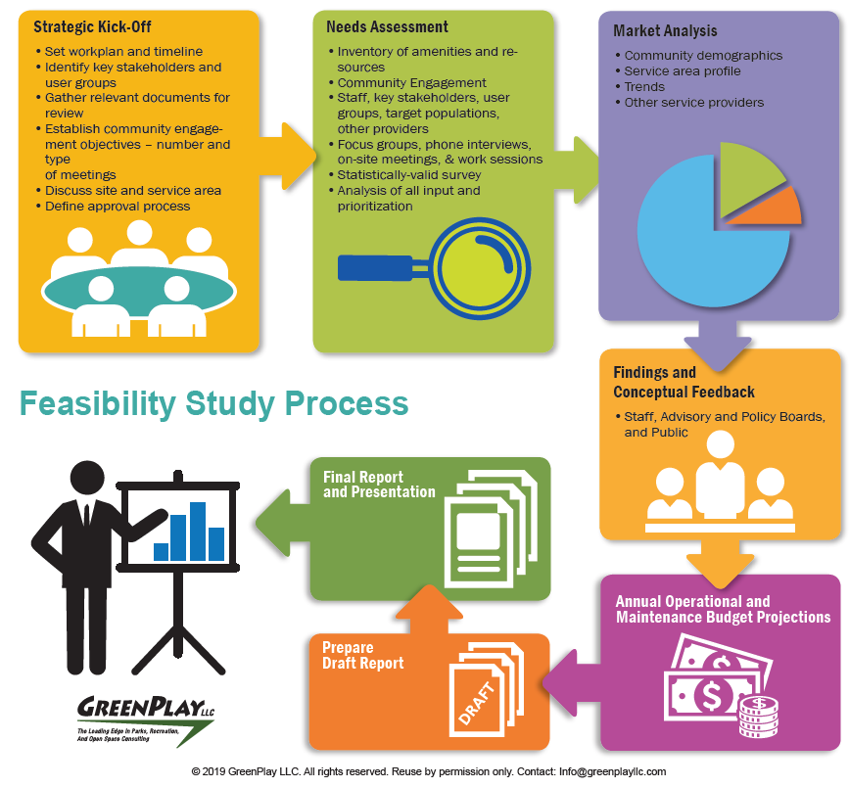

Slide 7
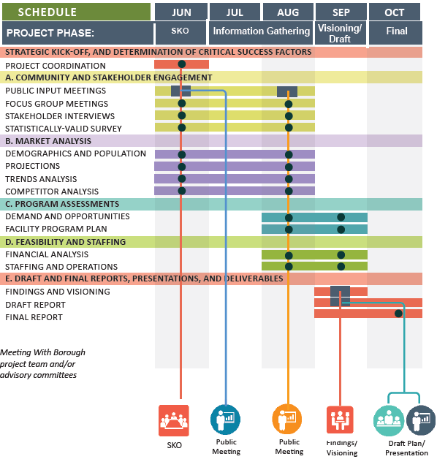

Slide 8
Information Gathering
Two(2) Focus Groups - 16 Participants
  Convention/Event users
  Key Stakeholders
  Hockey, Soccer, Basketball
  Military
  University
  Rotary Club
  Veterans
  Business Owners
Four (4) Stakeholder Interviews – 14 Participants
  Borough Leadership, University Athletics, ASM Global, Borough Park and Recreation staff
Thorough Review of Past Planning Documents
Tonight’s Public Forum

Slide 9
How long have you been a resident of the Borough?
<5 years 12.5%
5-9 years 0%
10-19 years 12.5%
20+ years 75%
Not a resident, but use facilities and services N/A

Slide 10
Poll Question
How many people are watching the meeting with you?

Slide 11
What are the strengths of Fairbanks North Star Borough (FNSB) Parks & Recreation?

Slide 12
Strengths of Parks & Recreation
Easy to work with, positive, responsive, professional, customer driven*
Wide reaching tasks. A lot of responsibilities. Public does not realize how much they do.
Identifying outside organizations to assist with programming/operations
Partnerships
Ability to listen
Represent Fairbanks very well
Diversity of parks/opportunities
Fantastic service
Affordable

Slide 13
Conversely, what are the weaknesses of the FNSB Parks & Recreation that need to be addressed through this study?

Slide 14
Weaknesses of Parks & Recreation
Over obligated
Understaffed
Confusion of who does what/who operates what
Lack of gymnasiums
No indoor soccer facilities
Many different facilities/infrastructures but no centralized facility with all the amenities in one location

Slide 15
Poll Question
Do you use or attend events at the Carlson Center?

Slide 16
What are the strengths of Carlson Center?

Slide 17
Strengths of Carlson Center (1 of 2)
Centrally located*
Large open spaces/largest gathering spaces
Flexible staff
Overnight slips
Trade shows
Great sheet of ice/vital to hockey
Only facility/venue in Fairbanks to hold large events/trade shows
Good parking capacity
Variety of types of events
Flexibility of the facility
Food and Beverage operations

Slide 18
Strengths of Carlson Center (2 of 2)
Centrally located*
Large events space
Tourism/Economic Impact opportunities
Large event space – trade shows, conferences, events, concerts, etc.
Ability to split up usage based on room configuration

Slide 19
Conversely, what are the weaknesses of the Carlson Center that need to be addressed through this study?

Slide 20
Weakness of Carlson Center (1 of 4)
Trying to be everything to everyone including hockey, trade shows, meetings, etc.*
Compared to the Big Dipper it is not maintained
Deferred maintenance is nonexistent
Bleachers incredibly old/parts not made anymore
Poor finishes for meeting space
Lack of funding to take care of everything
Poor condition of aging building/very tired/old
Empty many days of the year (mostly weekdays)
Hockey can use the facility more days per year
Last minute notice of cancellations for ice time
No one wants to be “on the ice” when it is covered as it is cold

Slide 21
Weakness of Carlson Center (2 of 4)
New COVID-19 guidelines equals a 33% reduction in available time
Taking ice out and putting back in
Very expensive space to operate, high utility bills high
Poor ice plant, cost of melting ice for other events is prohibitive
Financial situation in Alaska
Have many types of events but not great at any one
Cost prohibitive using a management company operating it
Lack of responsiveness of the management company – not community minded but profit driven
Not ideal for concerts with the sound equipment
Poor relationship with other service providers – collaboration versus competition

Slide 22
Weakness of Carlson Center (3 of 4)
Hockey limits ability to schedule other events during hockey season
Bonding of facility could limit any new uses
Lack of indoor recreational/program space
Hockey is higher quality at the Big Dipper than Carlson Center
UAF does not promote hockey very well at Carlson Center
Pricing model does not match the community
Disconnect between perceived price and perceived value of rental
Lack of partnerships that can lower subsidy and add usage
Relationship with operations vendor are not all positive, not working well
Public confuses about “who is responsible for what”

Slide 23
Weakness of Carlson Center (4 of 4)
Cannot have any other activities when hockey or large events are scheduled/UAF Hockey has exclusive use of entire facility
Management agreement needs to be improved – incentives need to be implemented
Quality staffing (11 FT 150-175 PT) is not adequate due to budget
Focused on revenue generation versus community needs
Prices too high
Lack of Cleanliness
Not willingness to work with groups
Facility should be operated locally and not by outside management group
Relationship between FNSB/UAF/SMG somewhat contentious

Slide 24
Poll Question
How satisfied are you with the management of the Carlson Center?

Slide 25
When considering the Carlson Center what additional activities do you feel should be offered that are currently not available?

Slide 26
Additional Activities for the Carlson Center
Indoor soccer
Fitness classes
Daytime PE activities for homeschoolers (FYSA sublease of facility, fund arena turf surface) – clinics, classes, programs, etc.
Physical activities for multiple groups during winter (like Big Dipper walking groups)
Birthday parties
Flag football
Lacrosse
Kickball

Slide 27
When considering the Carlson Center what additional events do you feel should be offered that are currently not available?

Slide 28
Additional Events for the Carlson Center (1 of 2)
Indoor soccer, baseball, softball, lacrosse, flag football, indoor football*
Youth hockey games/practices*
Large events – only facility in area that can host large events
Smaller trade shows
Conventions
Community-wide festivals
Art shows
Artisan gatherings

Slide 29
Additional Events for the Carlson Center (2 of 2)
Wedding receptions
Weekday activities
Turf time for tots
Food trucks
Basketball/Volleyball
“A day in the life of Fairbanks”
Track meets

Slide 30
When considering the Carlson Center what opportunities?

Slide 31
Opportunities for the Carlson Center (1 of 3)
Youth activities
Preschool
Partner with Pioneer Park – Program/Combined use
Indoor Playground
Teen Center/Teen activities
Indoor Turf – Soccer, Baseball, Softball, etc.
Gymnasiums – Basketball
Block street for large events/Pedestrian
Promote year-round activities
FNSB operate facility more feasibly than private management company

Slide 32
Opportunities for the Carlson Center (2 of 3)
Business model needs to improve the value of the experience that will add participation
Consolidating Parks & Recreation functions into the Carlson Center including maintenance
Fort Wainwright/NWR Partnership for events/activities
Fitness/Cardio/Weights
WiFi
Coffee Shop
Walking Track
Fitness classes/programs
Outdoor events with indoor amenities such as catering kitchen during the summer along the river

Slide 33
Opportunities for the Carlson Center (3 of 3)
Walking track
Open skate times
Community programs/activities
Meetings/Conventions
Guest Services Kiosk
LED reader boards
More community partners
Concerts (need to also perform in Anchorage
Bonded facility
Divide up the operations between several partners for efficiency

Slide 34
Poll Question
When considering the Carlson Center what do you feel should be the primary function of the facility to meet the need of the community?

Slide 35
When considering the Carlson Center what do you feel should be the primary function of the facility to meet the need of the community?

Slide 36
Carlson Center Primary Function
Hire a competent management group that can market the facility as well
Keep the Division I hockey program as a priority
Competing interests now
Indoor turf space during non-hockey times – system for inside the dasher boards as well as the entire space without the dasher boards
Indoor community gathering
Physical recreation/fitness space
Reduced pricing for community groups
Venue for large events (economic impact to community)
Multipurpose uses/activities
Be able to transition spaces for different activities

Slide 37
What new amenities would you like to see available?

Slide 38
Additional Amenities for the Carlson Center (1 of 2)
Indoor turf*
Walking track*
Large event space/venue*
Covered outdoor event space
Traffic controls (traffic lights, stop signs, roundabout, etc.) during large events
Multipurpose space
Storage
Locker Rooms*
Cross Training / fitness amenities
Flexible netting between turf fields, spectator seating, etc.
Indoor ropes course/obstacle course/adventure course (attached to ceiling)

Slide 39
Additional Amenities for the Carlson Center (2 of 2)
Fitness/weights/cardio space
Gymnasium space*
Food truck space
Competitive track
Indoor playground (can drop down from ceiling)
Adventure track
Filters for smoke (fires in community)
Food options
Kitchen expanded / Teaching kitchen
Expansion of Pioneer Room
Dome expansion
Expand the Carlson Center to accommodate multipurpose activities

Slide 40
Poll Question
What are the Top Ten Amenities needed for the Carlson Center?

Slide 41
Are there any portions of the Borough that are underserved?

Slide 42
Underserved
Indoor soccer participants
Middle school and younger
Seniors (Carlson Center)
Small children/tots (and parents of)

Slide 43
Who are the key partners and stakeholders in the community with regards to assisting with the management of the Carlson Center?

Slide 44
Key Partners and Stakeholders
University of Alaska - Fairbanks
Chamber of Commerce
Alaska Universal Productions (AV)
Love Inc. (Indoor inflatable park)
User groups
KO Productions
Advisory Groups
Explore Fairbanks
Festival of Fairbanks

Slide 45
What are the key issues and values that the FNSB Parks & Recreation needs to consider regarding the Carlson Center?

Slide 46
Key Issues and Values
Fairbanks Convention and Arts Center (would this project take that type of business from the Carlson Center)
Too many competing demands that do not work well together
Cost recovery goals for ongoing operations and maintenance
Trying to meet all the different communities’ needs
No defined schedule (practice time) for the University hockey team as a priority*
Youth hockey cannot schedule and count on the reservation of the ice arena
Dedicate sports areas within a sports facility (ice arena, turf, etc.) could help alleviate constant competition for the same space
New ice plant in the CIP plan (repair?)

Slide 47
What are the priorities that the FNSB Parks & Recreation needs to consider?

Slide 48
Top Priorities (1 of 2)
Trade shows/events*
Sports*
Athletic and fitness needs for all ages*
Develop a mission/vision for the Carlson Center that the community supports and to put a plan together that will be funded along with a cost recovery plan to fulfill the mission*
Indoor turf*
Improved ice arena*
Hockey and Soccer*
User groups funding the indoor turf and the ice plant
Need a new operator (FNSB or private/public partnership) of the Carlson Center*
Venue needs to be more affordable to rent

Slide 49
Top Priorities (2 of 2)
Fiscal / Cost Recovery
Decisions made by end of 2020
Maintenance
Energy upgrades
Serving community
Increased usage – daily
Operated by FNSB versus private management company
Lower fees and increase value to community
Offer recreational programs to community
Invite the community into the building for activities
Large event space – trade shows, conferences, events, concerts, etc.

Slide 50
What is your vision for the Carlson Center?

Slide 51
Vison for the Carlson Center
Carlson Center should function as a Community/Visitor Center – more diverse than hockey
Expand community use/community friendly – activities
Needs to be community based for year-round activities for local participation
Based on what the Borough/community wants it to be
“Community Center”
Ice less of a focus moving forward
Concerts, events, etc. as a focus
Balance what the community wants with a good business model of cost recovery
Hockey venue for University and community

Slide 52
Other comments, suggestions, feedback?
A Needs Assessment Survey will be deployed in the coming weeks

Slide 53
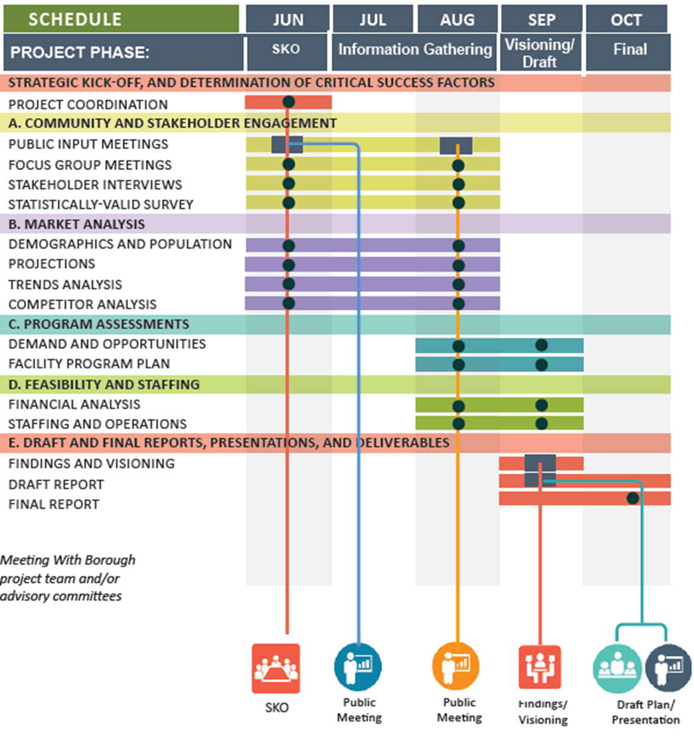
Next Steps

Slide 54

Thank You For Your Time & Consideration!
Pat O’Toole , Principal
Principal in Charge
Direct: 303-345-1804
Pato@greenplayllc.com
Tom Diehl, CPRP, Principal
Project Manager
Direct: 804.833.6994
Tdiehl@greenplayllc.com

